Slide 1

MIT School of Engineering Department of Information Technology and Engineering
MINI PROJECT REVIEW 1
Under guidance of Prof. Sumitra pundlik
A.Y.:2021-2022

Slide 2
Project title – scholarship portal
Group members:
Enrollment Number | Roll No. | Name of student | Email-id
MITU20BTIT0041 | 2205037 | Mohit Kodape | mohitkodape900@gmail.com
MITU20BTIT0027 | 2205040 | Harsh Sharma | harshsharma70830@gmail.com
MITU20BTIT0030 | 2205011 | Joshoua Simon | simonjoshoua23@gmail.com
MITU20BTIT0028 | 2205039 | Harsh Roy | harsh02roy@gmail.com

Slide 3
CONTENTS
Objective
Problem Statement
Introduction
Tech used for the project
Proposed work
UI OF PORTAL
STEPS & OUTPUT
Conclusion

Slide 4
Objective
To provide the user with an web site which
provides different types of scholarship information . Like Athletic scholarship , scholarship for minorities , Academic scholarship , Need base scholarship etc.

Slide 5
Problem statement – In an ocean of scholarships, it's hard to find and apply to the right one. Scholarships are everywhere. In today’s fast life it is difficult for users to get scholarships at their move .
Problem solution – To develop an website , this will help people to get any scholarships on the tip of their fingers. This portal gets updated everyday so that people can catchup to the latest requirement for different scholarship and how to apply for it with reference Url .
Technology used – html , css , java & JavaScript , MySQL, PHP

Slide 6
Introduction
What is html & css ?
HTML (the Hypertext Markup Language) and CSS (Cascading Style Sheets) are two of the core technologies for building Web pages. HTML provides the structure of the page, CSS the (visual and aural) layout, for a variety of devices.
What is My SQL ?
MySQL is an open source relational database management system
For scholarship sites, that means it helps you store all your blog posts, users, plugin information, etc.
It stores that information in separate “tables” and connects it with “keys”

Slide 7
What is My PHP ?
PHP is a language that gives you the flexibility to connect and work with different databases while developing your webpage.

Slide 8
application for database .
XAMPP
It provide the functionality of operation and managing MySQL over the internet .
It provide the creation of the MySQL database using phpMyAdmin
Use as a local host/server .

Slide 9
What is scholarship web portal ?
Scholarship web portal is a simple site for searching and retrieving live articles from all over the colleges and agencies. You need an API key to fetch information from a given source , it contains information about various fields like for example :-
Scholarship for different state level.
Scholarship for athletic .
Scholarship given by governments for backwards classes etc.

Slide 10
Proposed work
As world’s technology is rapidly growing everyone has fast connection and network to instantly connect to other person.
Day to day use in tablets and laptop is increasing, most of the people already have this facilities. In this fast and information oriented world we need to stay updated with every new kind of scholarship given by agencies.
This web portal has access to latest scholarship info from across 32+ states.
The main focus of this web portal is to get information from all around the world and deliver it to user as fast as possible in best visualize way.

Slide 11

output

Slide 12
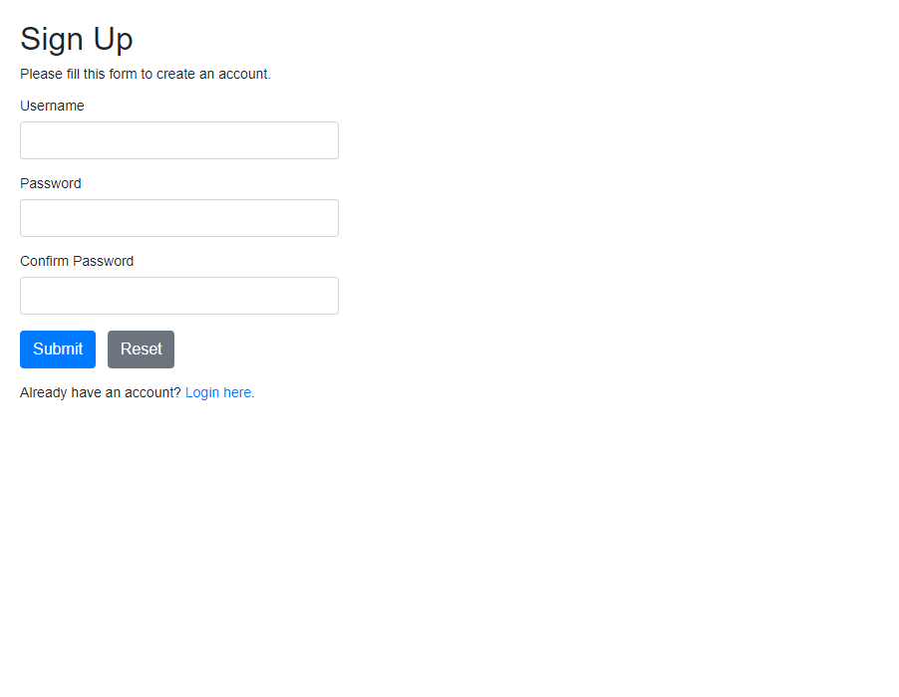
login page of portal

Slide 13
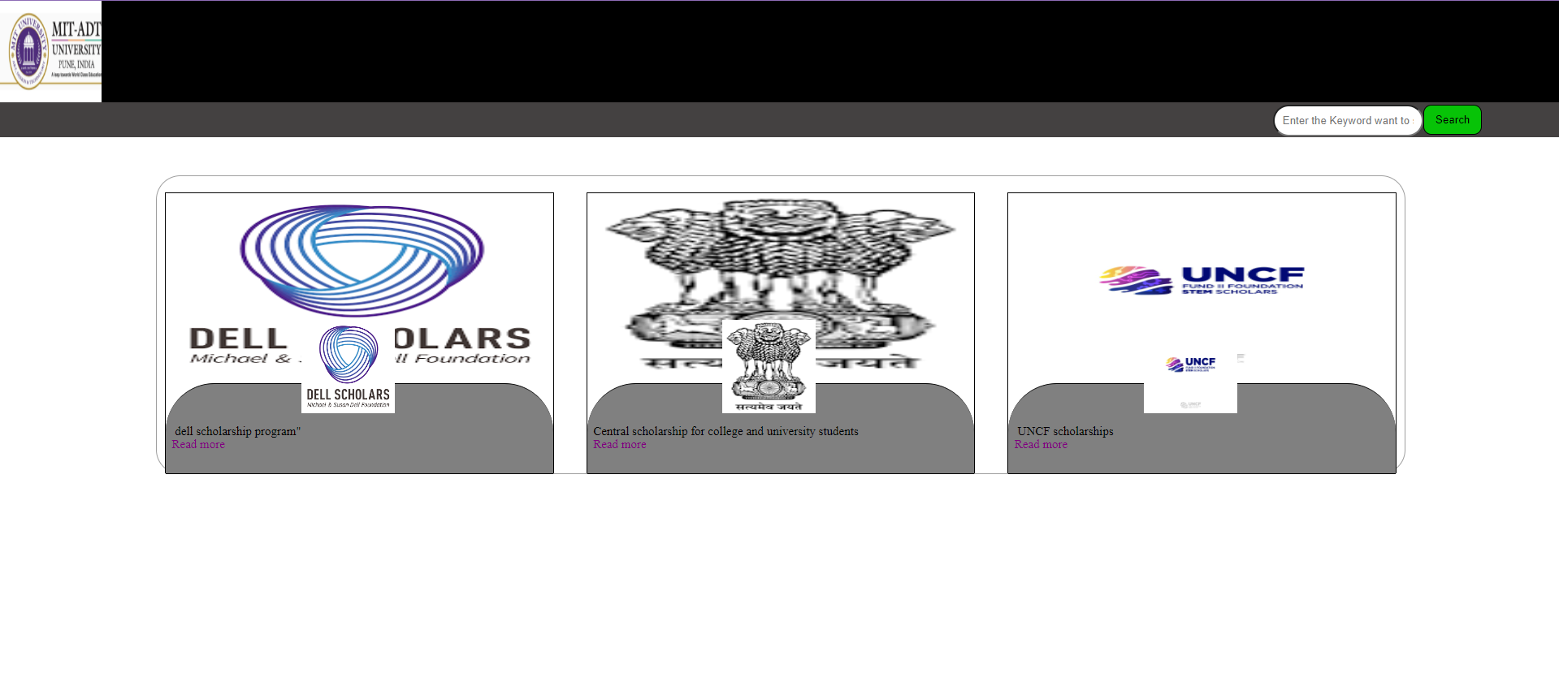
types of scholarship data on portal

Slide 14
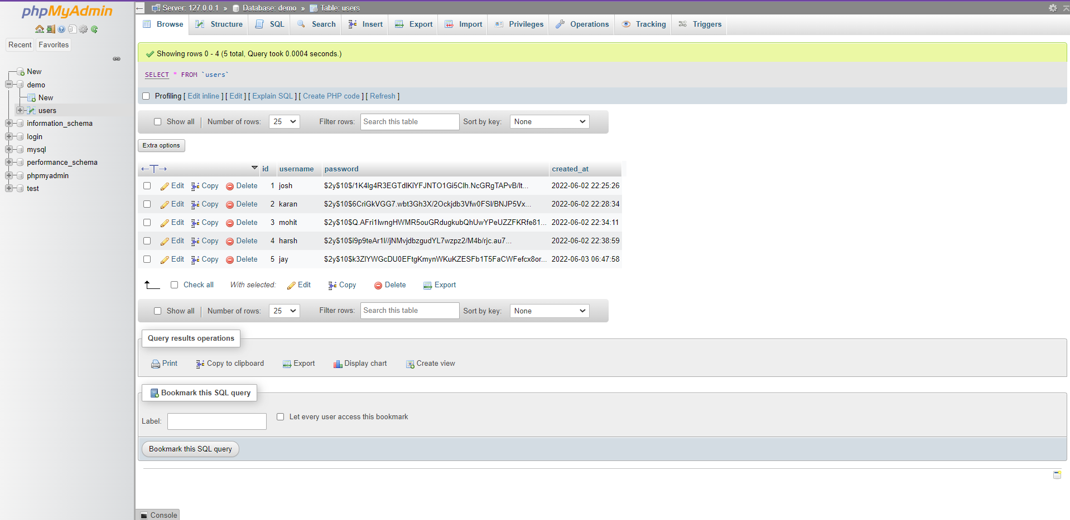
screen shots of database

Slide 15
Future scope . benefits of national scholarship portal
Ensure timely disbursement of Scholarships to students.
Provide a common portal for various Scholarships schemes of Central and State Governments.
Create a transparent database of scholars.
Avoid duplication in processing.
Harmonization of different Scholarships schemes & norms
It is an source of income.

Slide 16
Conclusion
The main objective behind developing this web portal project is to provide a system for the colleges and agencies where they can share every new information of scholarship to their customers/client .
Not only this but even the people who desire to seat for scholarship exams that can also be possible to access and apply from given reference portal.
All they need to do is to visit the web portal and then, they can find scholarship themselves with according to there needs with no problems.

Slide 17
Thank you …….

